Slide 1
Requirements-Based Testing Example
By Pat Canny

Slide 2
What is the “Requirements-Based Testing” Example?
Simulink Project with Live Script containing guided instructions
Based on an all-day workshop created by Chuck Olosky from AEG
Focuses on a Tester persona
Built using R2019b
Uses Simulink Requirements, Simulink Test, Simulink Coverage, and SLDV
Assumes basic knowledge of Simulink and Stateflow

Slide 3
Why Was It Created?
Intended audience: existing Simulink users considering the V&V tools
The existing “reference workflow” in Documentation is dated
New features in SL Test and SL Coverage for requirements-based testing came out in 19b
Sales team has asked for a good “leave-behind” example for customers

Slide 4
Where Can Users Find It?
The example is publicly available on File Exchange
Internal MW users can find it on GitLab
This version will be kept more up-to-date than File Exchange

Slide 5
How Should We Present This To Customers?
Use it as a workshop
Provide a link after a demo
Use it before an eval

Slide 6
Workflow Back Story / Motivation
User is a control systems engineer at a fictional company called Farnswerth Automotive
User is working on a Level 5 autonomous vehicle called The Pod, which can travel within 1 meter of other Pods at 100 km/h
User is testing the cruise control algorithm developed by a colleague
The team is in a hurry! They want to get in the fancy new lab!
Notes:
The name Farnswerth Automotive is derived from Philo Farnsworth , Hubert Farnsworth, and the Farnsworth Art Museum

Slide 7
Workflow Description
Two Parts
Part 1: Create a Test and Link to Requirement
Part 2: Run a Test Suite and Resolve Missing Model Coverage
User is guided through three parts via Instructions.mlx (Live Script)

Slide 8
Part 1: Create a Test and Link to Requirement
Create a single test case using a temporal assessment. Link to requirement.
The goals for this part are to learn how to:
create a test harness
create a temporal assessment to define pass/fail criteria
create a test case using the harness and the assessment
link the test case to the requirement
execute the created test case to determine whether the test passed

Slide 9
Part 2: Resolve Missing Coverage
Run a test suite and resolve missing model coverage
The goals for this part are to learn how to:
execute a test suite using Simulink Test
measure test coverage
generate tests to analyze missing test coverage
resolve missing test coverage

Slide 10
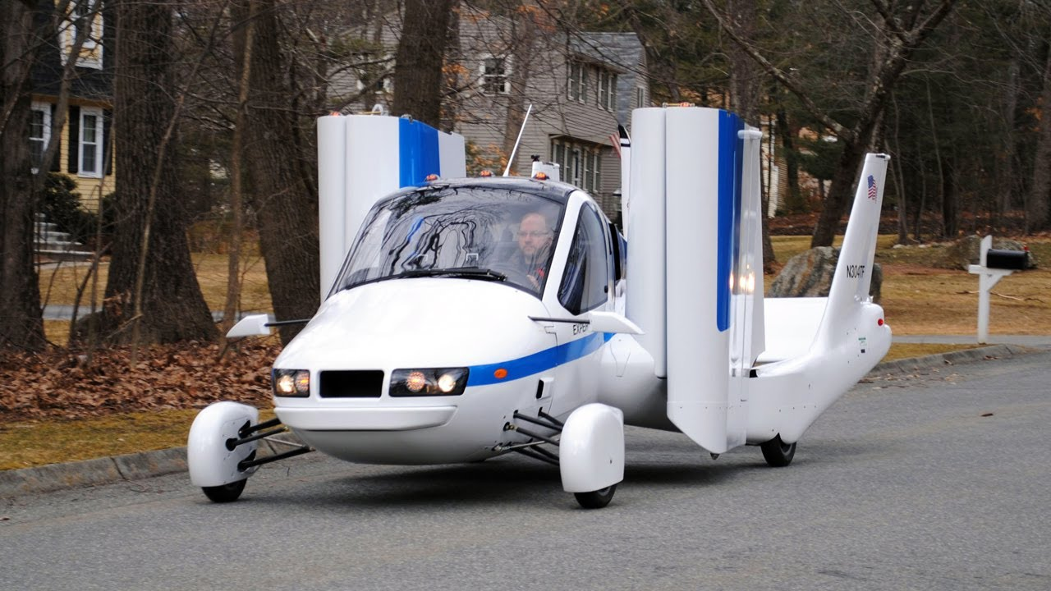
What’s Next?
Video series ✓
AeroDef version?
Updated Designer example?
Terrafugia’s “Transition” Vehicle
(photo likely taken near Pat’s house)

